Slide 1
C# for test automation
Introduction to GIT
Module 1
Notes:
https://learngitbranching.js.org

Slide 2
Agenda
What is git?
Git tools
What is repository?
The .gitignore file
Practice 1
Coffee break
The three states of a file in git
Three main sections of a git project
​What is a commit​?
Practice 2
Coffee break
Upload changes
Download changes
Practice 3
Lunch
What is a branch​?
What is a cherry pick​?
Practice 4
Coffee break
Merge vs rebase
What is pull request?
Practice 5
What is a git stash​?

Slide 3
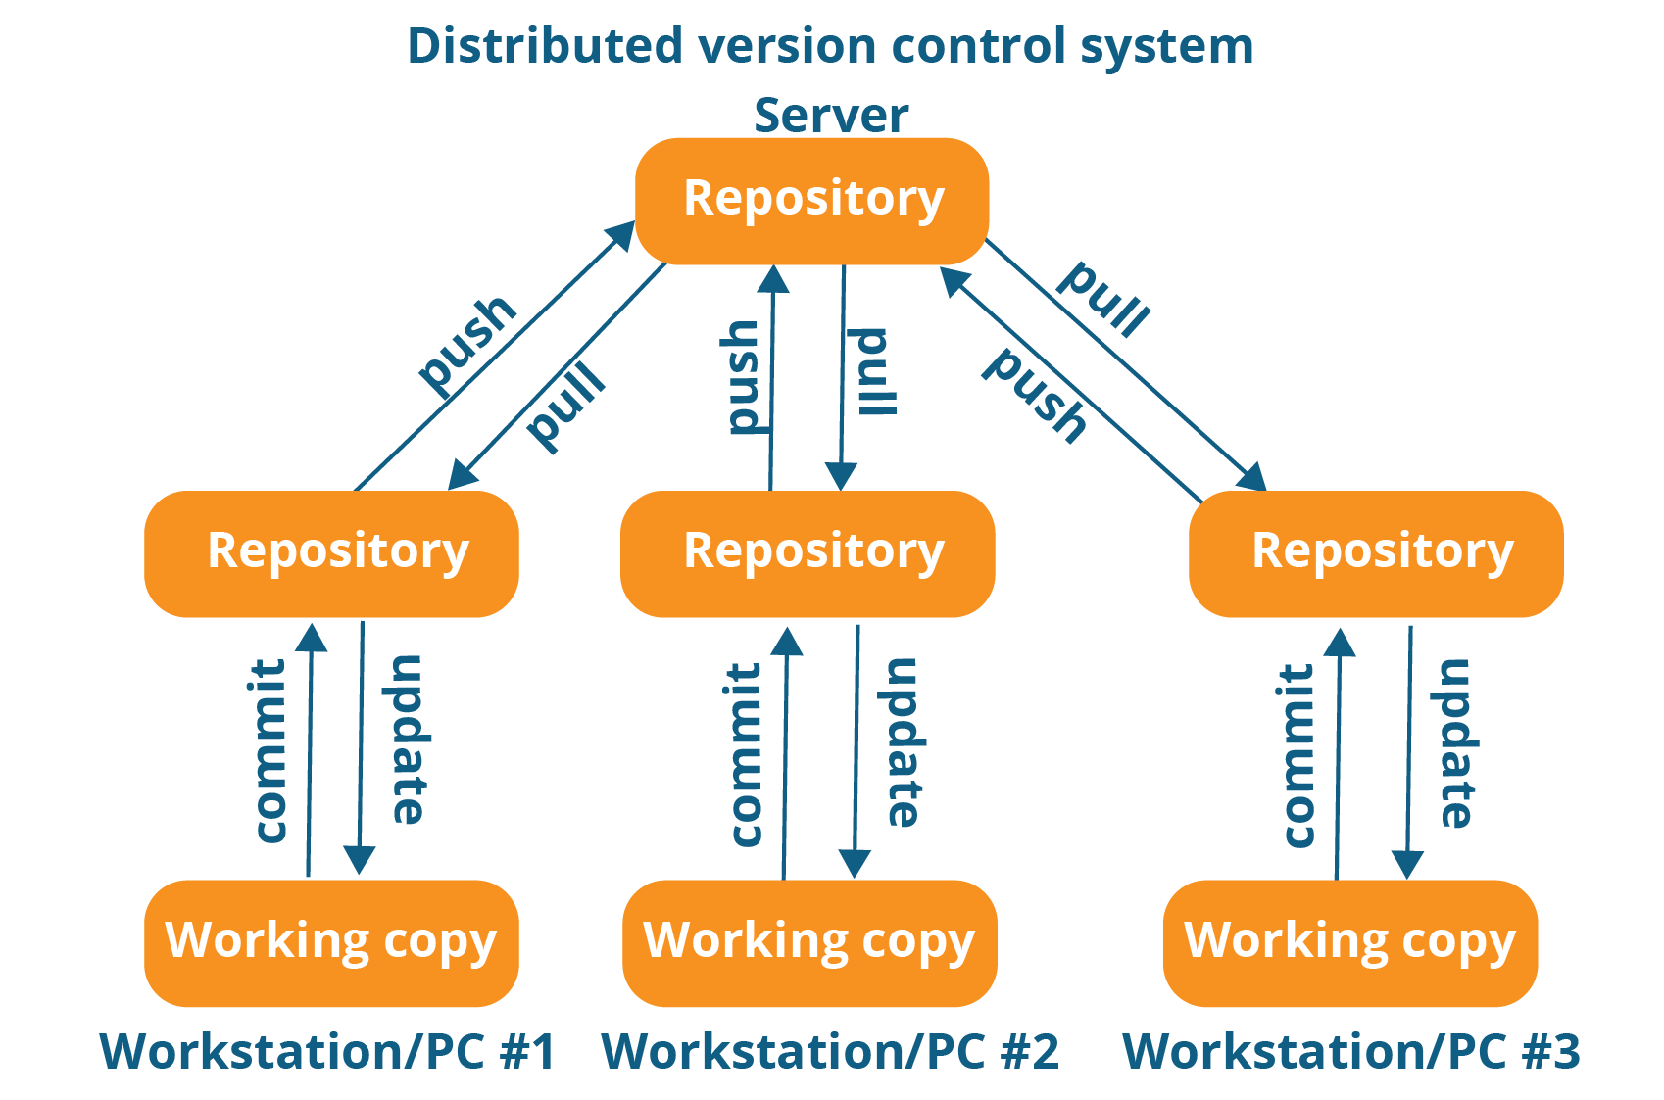
version control system
What IS git?
Git is a free and open-source distributed version control system designed to handle everything from small to very large projects with speed and efficiency.
Clients fully mirror the repository that lives on the server, including its full history (maintain a clone)​

Slide 4



version control system
GIT tools
You can pick your tools when working with git, options include:​​​
  the command line​​
  Visual studio built-in client​​
  Various GUI Clients (list)​

Slide 5
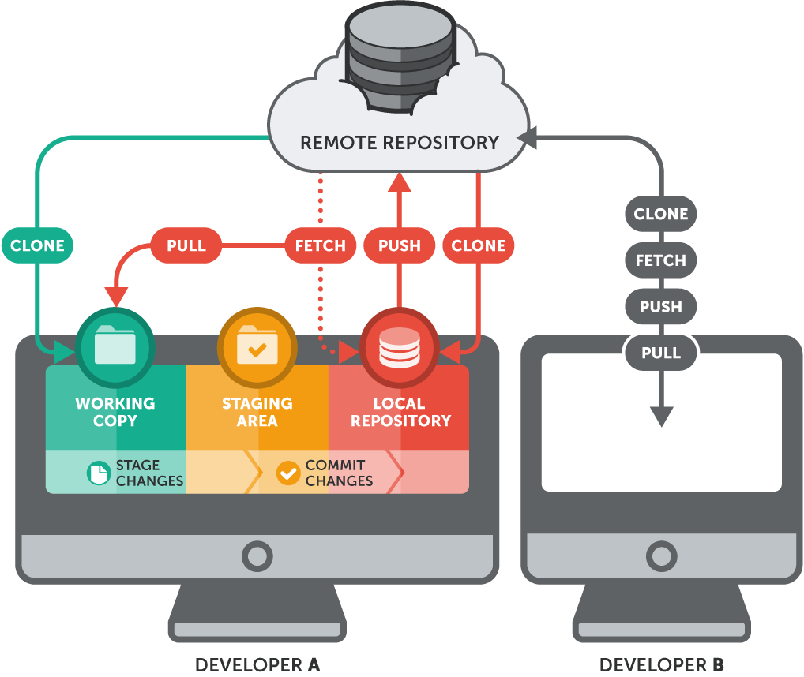
LOCAL/REMOTE REPOSITORY​
What IS REPOSITORY?
Local Repository: ​
User’s local copy of the repository, with all files and their revision history​​
Remote Repository: ​​
a server where all the collaborators upload their changes​
You do all the work on your local repository, then you update the remote with your changes (and get the changes of your teammates from the remote)​

Slide 6
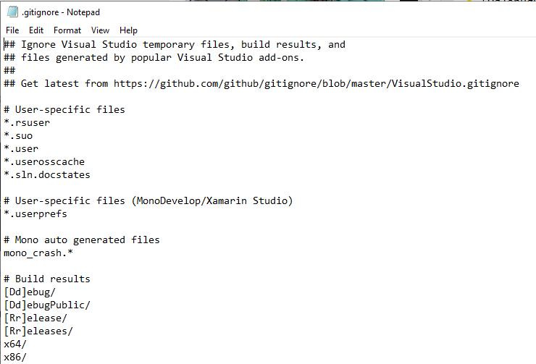
gnoring files
The .gitignore file
There are files that we don’t ever want to commit, for example our .suo file in Visual Studio, temporary files, our bin folder etc.
We can tell git to ignore them and not track them by using the .gitignore file. These files will not appear as modified when there are changes.
There is a pre-setup .gitignore file specifically for Visual Studio here that we can use and customize it if needed
Ignore file extensions
Ignore directories

Slide 7

LOCAL/REMOTE REPOSITORY
Practice 1
Create an empty console application (.NET Framework) – MyConsoleApplication
Add .gitignore file and fill it with default settings for Visual Studio - link
Add your solution to GitHub
  Create a new repository - https://github.com/new
  Repository name - MyConsoleApplication
  Push a new repository to remote, please be aware to execute git commands in the root directory of your solution
  git init
  git add .
  git commit -m "first commit"
  git remote add origin https://github.com/XXXX/MyConsoleApplication.git
  git push –u origin master
  ream
initialize local repository
stage all files
commit staged data
bind remote repository
push committed data to remote

Slide 8

Coffee Break

Slide 9
LOCAL/REMOTE REPOSITORY​
THE THREE STATES OF A FILE IN GIT​
Modified: we simply make a change to a file and save it, then it is in modified state​​
Staged: we mark a modified file to be included in the next commit (using git add or git stage)​​
Committed: we use the commit command and then this change is stored in the local repository database
You do all the work on your local repository, then you update the remote with your changes (and get the changes of your teammates from the remote)​

Slide 10
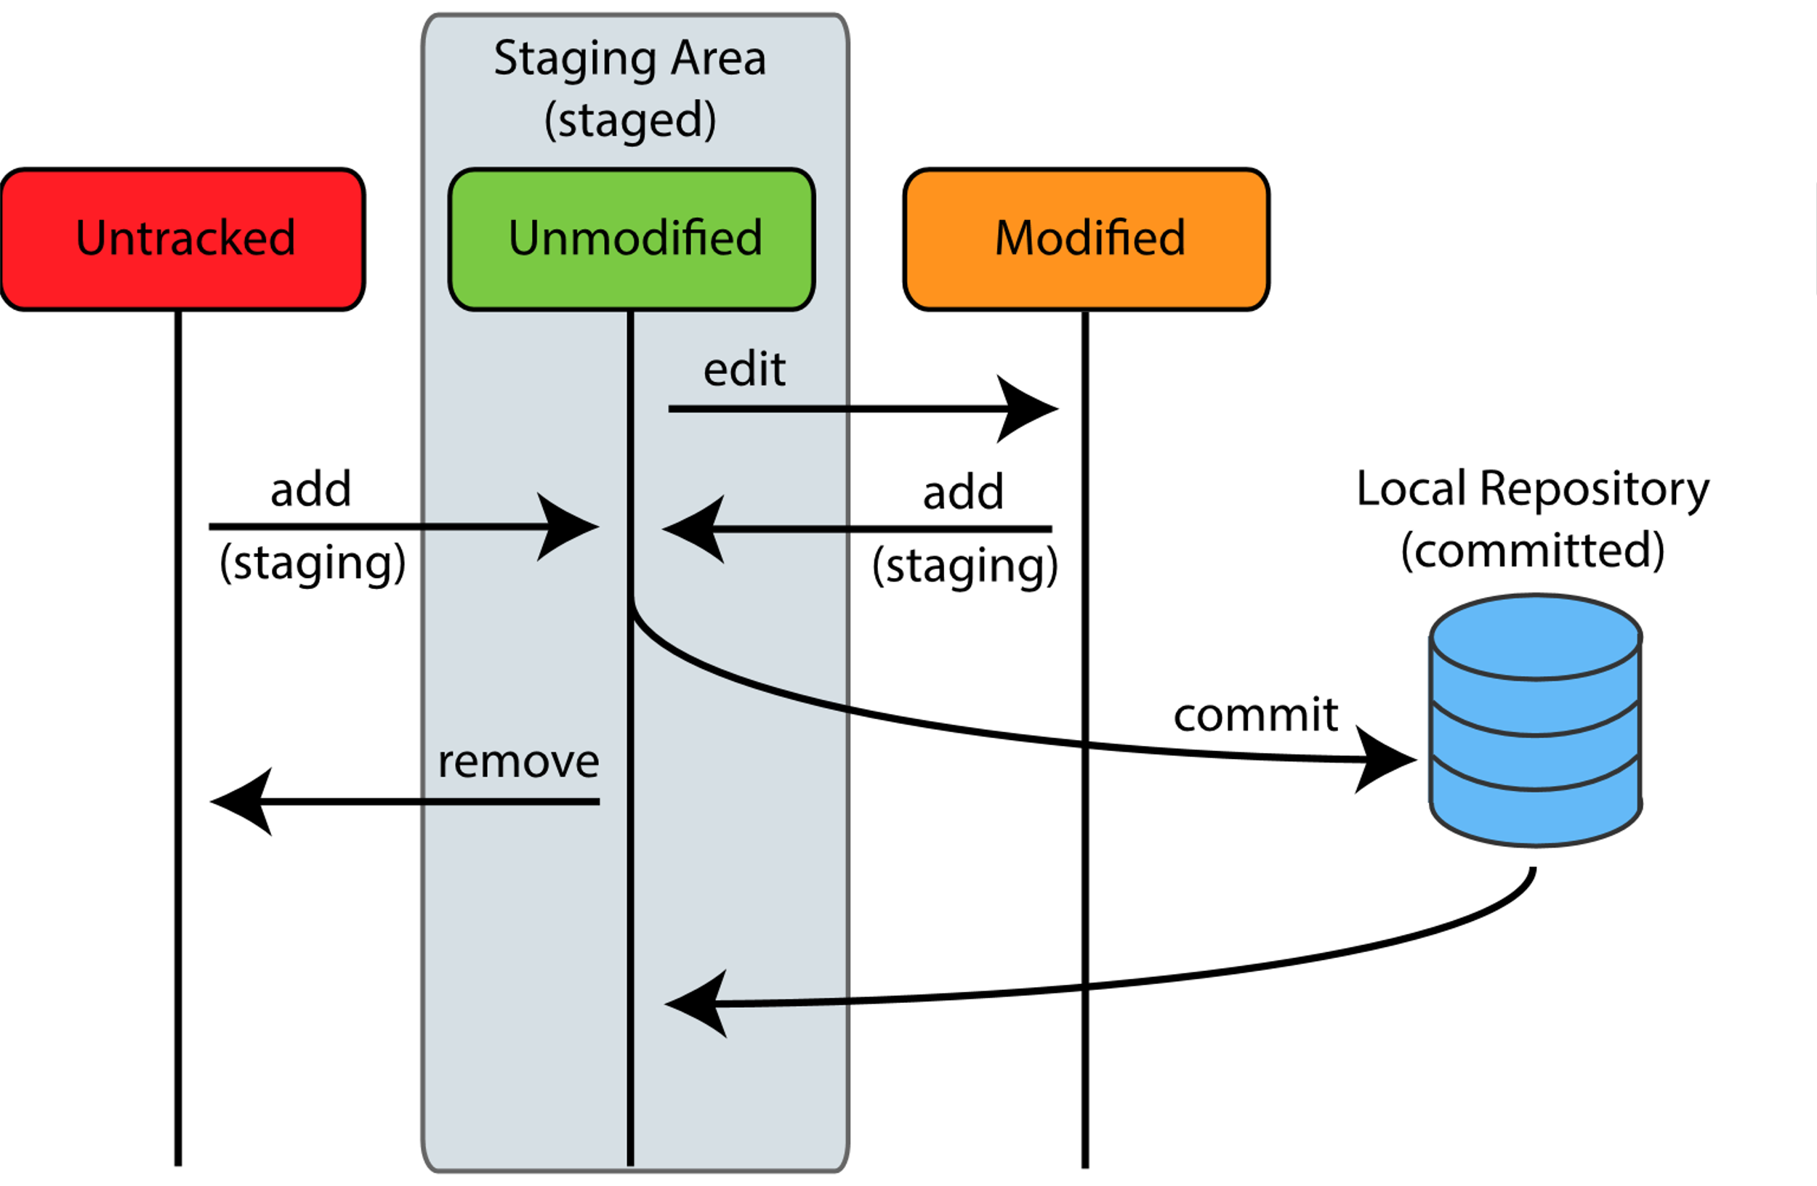
LOCAL/REMOTE REPOSITORY​
THREE MAIN SECTIONS OF A GIT PROJECT​
The working tree: a checkout of one version of the project. ​​
The staging area (or the index): a file that stores information about what will go into your next commit ​​
The Git directory: a directory with all the project metadata and the object database.

Slide 11
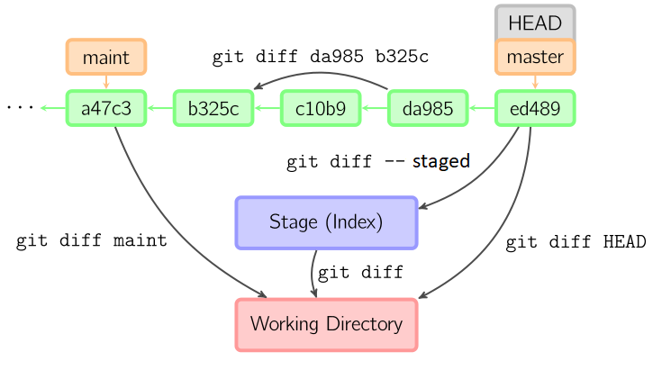
LOCAL/REMOTE REPOSITORY​
GIT DIFF COMMAND
git diff View difference between Stage and Working Directory
git diff --staged View difference between HEAD and Stage
git diff HEAD View difference between HEAD and Working Directory

Slide 12
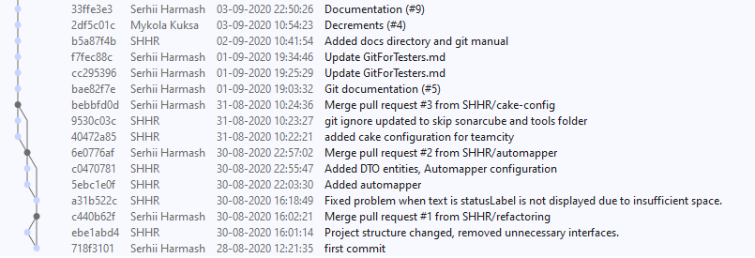
“SAVING” YOUR CHANGES​
WHAT IS A COMMIT​?
Commit: a saved snapshot of the repo with a set of changes in one or more files​
  Making a commit = saving the staged changes​
  each commit has a unique id (“hash”) and includes author, timestamp and a message​
  The commit’s parent: the commit on top of which the commit is applied

Slide 13
COMMIT
Practice 2
Modify the Main method in your project by adding: Console.WriteLine("Hello world!");
Execute git status command in the root directory of your solution.
  What is the status for Program.cs file?
  Can you commit changes at this moment by using git commit –m ‘commit message’?
Execute git diff command. Can you see the difference between initial and modified file?
Stage the changes by executing git add .
  Try to execute git status and git diff again, has something changed?
  Try to execute git diff Head. Can you see the difference now?
Commit the changes
Check the remote repository, has something changed?

Slide 14
Coffee Break

Slide 15
“Sync” with the remote 1
Upload changes
Push: transfer the changes from your local branch to the remote repository (will only upload the committed changes)
Working Tree
Staging area
Local Repo
Remote Repo
add/stage
commit
push

Slide 16
“sync” with the remote 2
Download changes
Fetch: downloads new data from a remote repository - but it doesn't integrate any of this new data into your working files, it only updates the local remote copies
Pull: downloads new data and integrates it into your current working copy files – equivalent to fetch + merge

Slide 17
Working Tree
Staging area
Local Repo
Remote Repo
add/stage
commit
push
fetch
pull

Slide 18
“Sync” with the remote
Practice 3
Upload changes from the previous practice to remote repository by executing command git push
Go to GitHub and open your repository, find the changed file and view the changes history
Ask your coach to push any change in your repository
  Make sure that your coach is added to project collaborators
  Do you see this change in remote/local repository? Try to execute git status command.
  Try to execute git fetch command, has something changed in your working directory? Why?
  Try to execute git pull command, has something changed in your working directory?

Slide 19

LUNCH

Slide 20
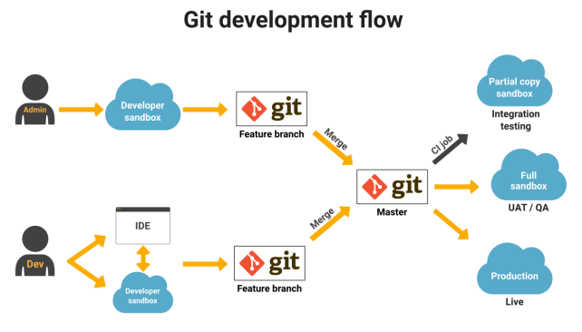
BRANCHES
Git development flow
Git workflow helps with continuous software development and implementing DevOps practices.
Instead of a single master branch, this workflow uses two branches to record the history of the project. The master branch stores the official release history, and the develop branch serves as an integration branch for features.

Slide 21

BRANCHES​
WHAT IS A BRANCH​?
A branch is used for a parallel version of a repository​
You working independently from the main branch in an independent series of commits​
Basically, a pointer to the “tip” of our parallel version (the last commit)​
HEAD: (a pointer to) the last commit on the current branch we are on

Slide 22
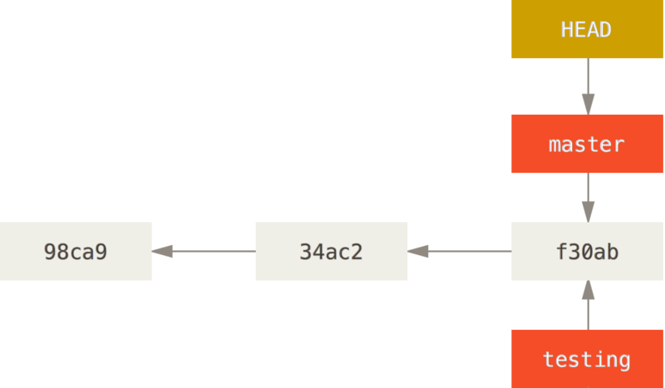
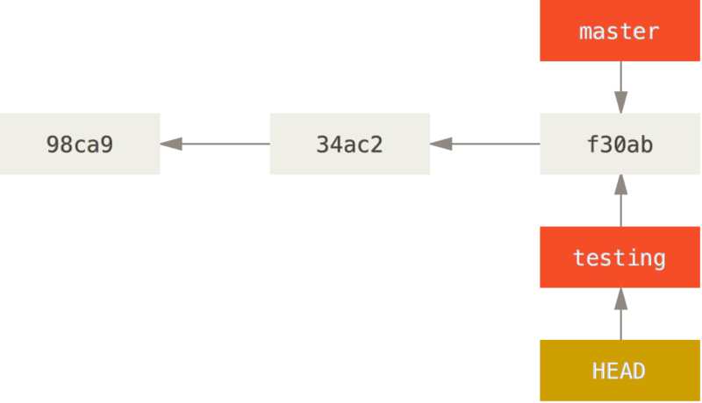
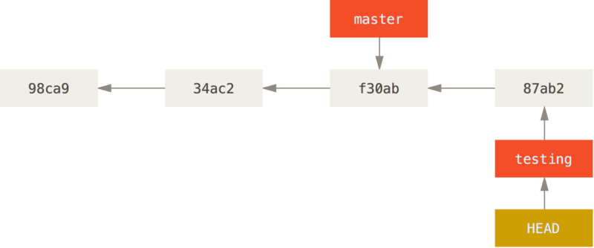
BRANCHES​
WHAT IS A BRANCH​?
HEAD: (a pointer to) the last commit on the current branch we are on
HEAD pointing to a branch
HEAD points to the current branch
The HEAD branch moves forward when a commit is made
Notes:
https://git-scm.com/book/en/v2/Git-Branching-Branches-in-a-Nutshell

Slide 23
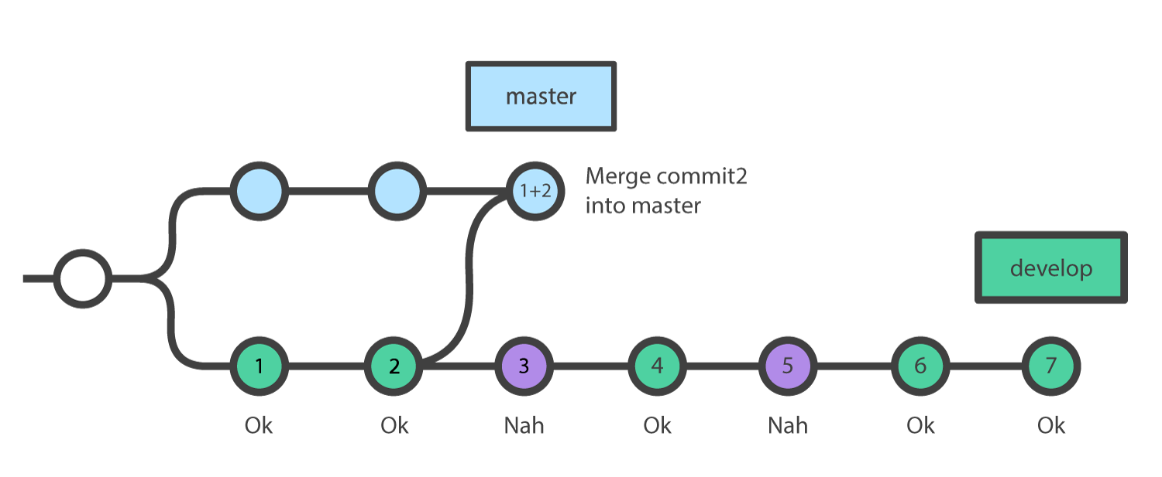
BRANCHES​
WHAT IS A CHERRY PICK​?
Cherry picking in Git means to choose a commit from one branch and apply it onto another.
This is in contrast with other ways such as merge and rebase which normally apply many commits onto another branch.

Slide 24
BRANCHES
Practice 4
Create a new branch by using git branch ‘education’
  Execute git branch to view all branches
  Are you still at master branch?
Switch to ‘education’ branch by using git checkout education
Change Program.cs file by modifying a message printed into console.
Commit your changes and push to remote repository (git push --set-upstream origin education)
  Do you see the pushed changes in the remote repository?
Ask you coach to publish a new branch named – ‘fetch_command_example’
  Execute sequentially git branch, git branch –a, git fetch and git branch -a
  Can you explain what each command did and why?

Slide 25
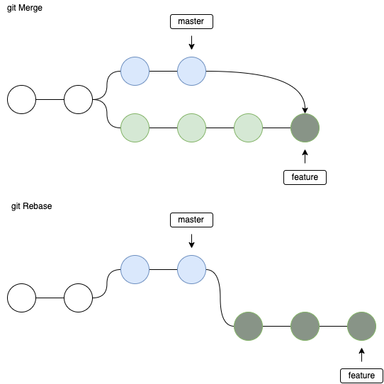
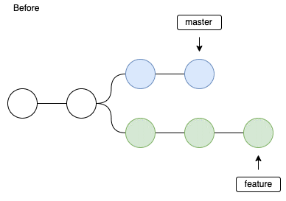
Integrate changes from one branch to another
Merge vs rebase
Merge: Apply the changes of one branch to another branch, adds a merge commit
Rebase: Reapply a series of changes from a branch on top of another, and reset the head of that branch to the result

Slide 26
Coffee Break

Slide 27
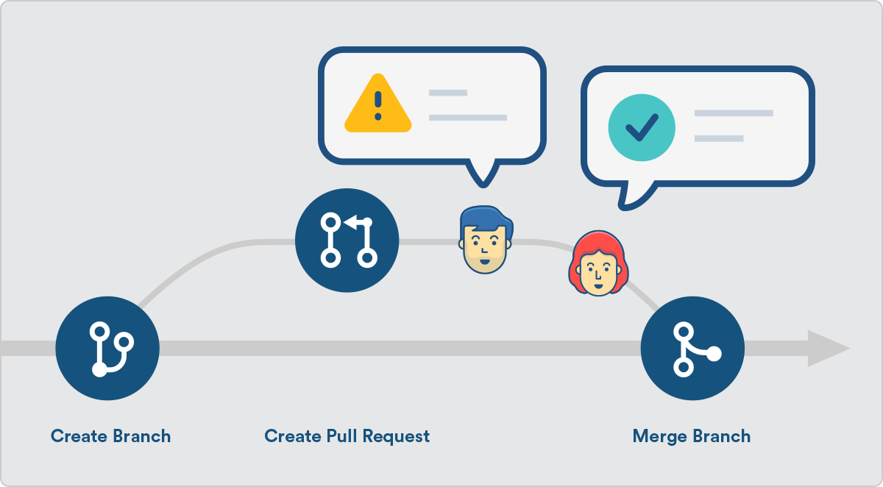
Pull requests
What is pull request?
When you are ready with your work on your feature branch you can merge it to the master branch, but you want teammates to review and approve your changes first
The Pull Requests that we use on GitHub is not a git feature, it is offered by GitHub as an extra feature for collaboration

Slide 28
PULL REQUEST
Practice 5
Create a pull request ‘education’ branch to ‘master’
Ask your coach for a code review
Ask your coach to create a pull request for you and to be assigned on a code review activity
Approve the changes and merge

Slide 29
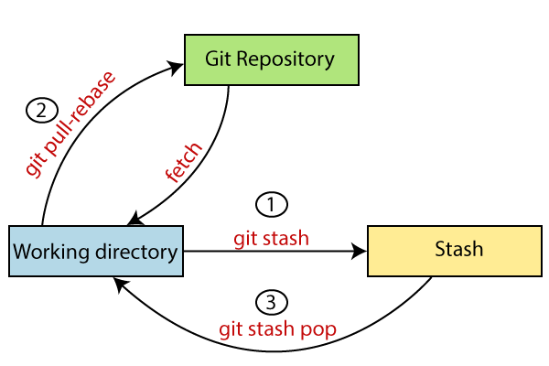
STASHING​
WHAT IS A GIT STASH​?
Sometimes you want to switch the branches, but you are working on an incomplete part of your current project. You don't want to make a commit of half-done work. Git stashing allows you to do so. The git stash command enables you to switch branches without committing the current branch.
The below figure demonstrates the properties and role of stashing concerning repository and working directory.
Notes:
Generally, the stash's meaning is "store something safely in a hidden place." The sense in Git is also the same for stash; Git temporarily saves your data safely without committing.
https://www.javatpoint.com/git-stash

Slide 30
STASHING​
STASH, APPLY
To save changes temporarily, we can use the git stash command.
The git stash command is used as:
To check the stored stashes, run the below command:
You can re-apply the changes that you just stashed by using the git stash command. To apply the commit, use the git stash command, followed by the apply option. It is used as:
Notes:
Generally, the stash's meaning is "store something safely in a hidden place." The sense in Git is also the same for stash; Git temporarily saves your data safely without committing.
https://www.javatpoint.com/git-stash

Slide 31
STASHING​
POP, DROP
We can track the stashes and their changes. To see the changes in the file before stash and after stash operation, run the below command:
Git allows the user to re-apply the previous commits by using git stash pop command. The popping option removes the changes from stash and applies them to your working file.
The git stash pop command is quite like git stash apply. The main difference between both commands is stash pop command that deletes the stash from the stack after it is applied.
The git stash drop command is used to delete a stash from the queue. Generally, it deletes the most recent stash. Caution should be taken before using stash drop command, as it is difficult to undo if once applied.
The only way to revert it is if you do not close the terminal after deleting the stash. The stash drop command will be used as:
Notes:
Generally, the stash's meaning is "store something safely in a hidden place." The sense in Git is also the same for stash; Git temporarily saves your data safely without committing.
https://www.javatpoint.com/git-stash

Slide 32
Homework

